Slide 1
Build a Better World Adult Webinar
Mac Buntin
Mississippi Library Commission

Slide 2
Adult SLP?
This is just like much of the programming that you offer throughout the year – the difference is that it focuses on the annual theme.
How do you “Build a Better World?”

Slide 3
Adult Incentives
Are they necessary?
What has appeal to local adults?

Slide 4
Programming
Active
Passive

Slide 5
Check out the CSLP website
https://www.cslpreads.org/programs/adult-program/yearly-program/
Adult Programming in Libraries
Sample Adult Summer Reading Programs
General Adult Programming Resources
The state of Missouri has also produced an Adult Program Webinar. You are able to view this program by navigating to:
2017 CSLP Program Manual Webinar Archives and selecting the adult program.

Slide 6
The Adult SLP Manual
Preparation & promotion
Program suggestions
At Home
In the Community
Throughout the Country
Around the Globe
Reproducibles & Samples
Resources

Slide 7
Books!

Slide 8
Programming idea
Use titles and authors suggested in the manual for a “blind date” display.

Slide 9
Programming idea
Kansas City Public Library’s guide to conducting book clubs.
http://www.kclibrary.org/?q=book-clubs/guidelines

Slide 10
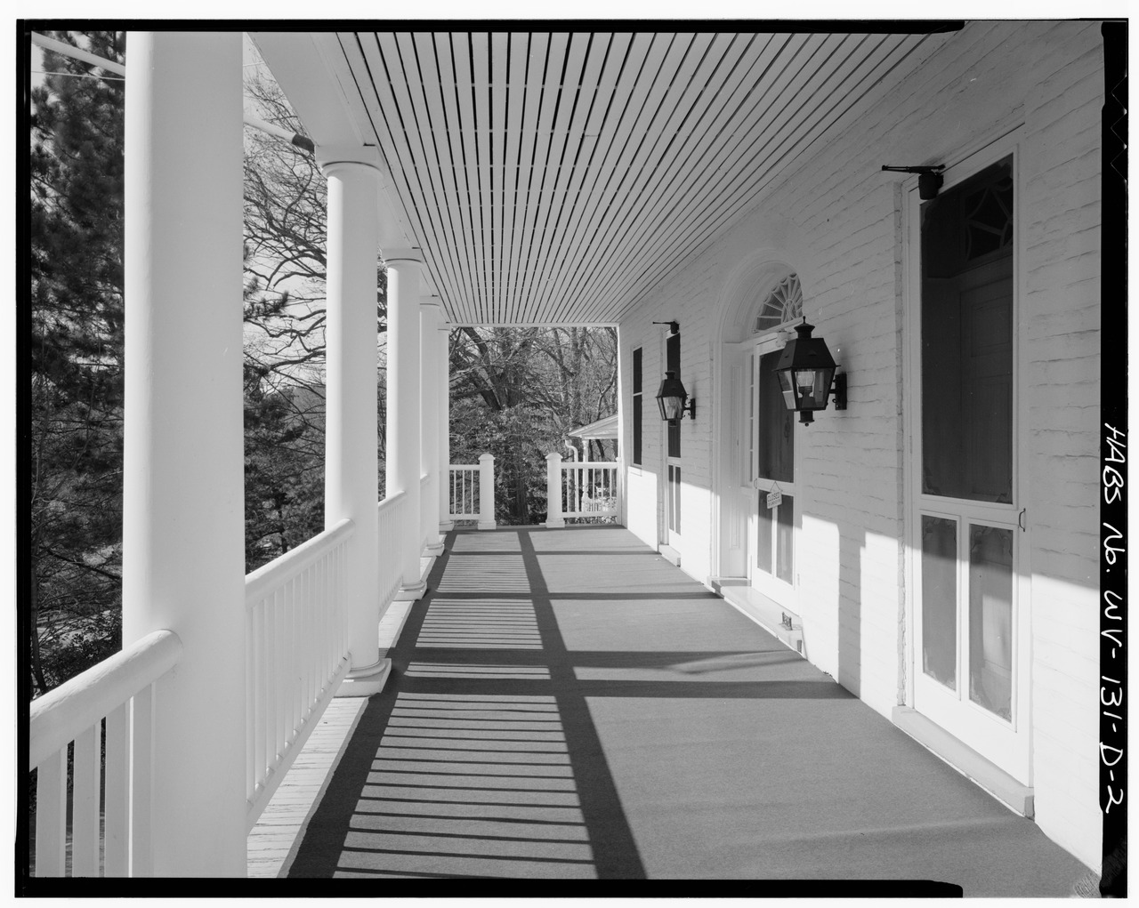
At Home
By http://www.loc.gov/pictures/item/wv0226.photos.172205p, Public Domain, https://commons.wikimedia.org/w/index.php?curid=34540805

Slide 11
At Home
Composting
Natural cleansers
Couponing
Growing food from scraps
Plan family meals
Declutter

Slide 12
Programming idea …
Host a program or provide information about the disposal Household Hazardous waste

Slide 13
In the Community
By Ken Lund from Las Vegas, Nevada, USA (Oxford, Mississippi Town Square) [CC BY-SA 2.0 (http://creativecommons.org/licenses/by-sa/2.0)], via Wikimedia Commons

Slide 14
In the Community
Repurpose – pallets, concrete blocks
Recycling
Support local businesses
Notes:
.

Slide 15
Programming idea …
Identify groups that support the free exchange of unwanted, but working items.
There are online groups like Nextdoor and Craigslist
Think about promoting barter in your community - Could your library host a swap?

Slide 16
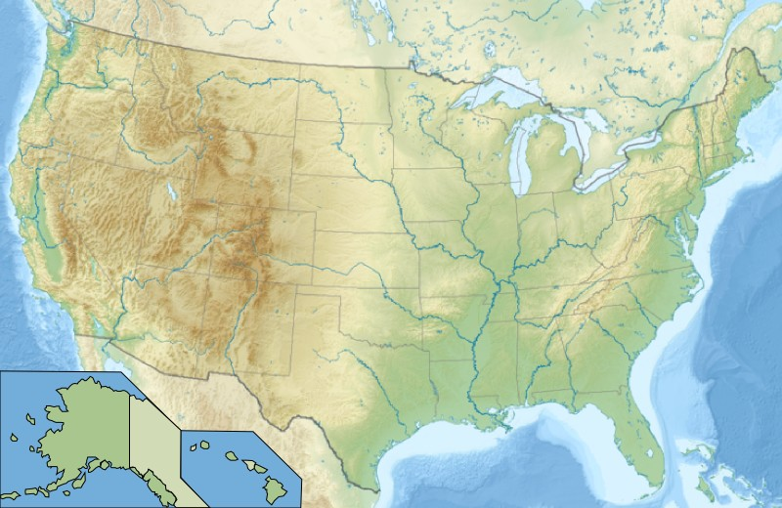
Throughout the Country
By Wikisoft* @@@-fr 09:06, 14 January 2011 (UTC) - File:Usa edcp relief location map.png, GFDL, https://commons.wikimedia.org/w/index.php?curid=12689827
Notes:
.

Slide 17
Throughout the Country
Support national organizations
Educate yourself about state and national politics
Watch national news programs
Explore ways that your state contributed to the building of the US
Investigate the contributions of minorities to the growth and well being of the US

Slide 18
Programming idea
http://msreads.lib.ms.us/bingo/

Slide 19
Around the Globe
By ptwo from Germany and UK (1492) [CC BY 2.0 (http://creativecommons.org/licenses/by/2.0)], via Wikimedia Commons

Slide 20
Around the Globe
Micro economics (micro loans)
Buy from people, not companies
Educate yourself about different countries & cultures
Make friends with people from other countries
Watch international news

Slide 21
Movies
Don’t show movies to the public unless you have the necessary movie license. This is discussed on page 12 of the manual!
You can develop a program using movie titles available from the library - create a list of titles held locally that explore other countries and cultures.

Slide 22
Local Events & Groups
What is happening locally that could help you have a great program?
Are there any local groups that help you get a global or multicultural feel to your adult programming?
Notes:
.

Slide 23
Mac Buntin mbuntin@mlc.lib.ms.us

